Slide 1
Endowment Analytics
Hao Sun/Yichao Li/Le Zhang/Ao Li
12/05/2018

Slide 2
Data Manipulation & Visualizations

Slide 3
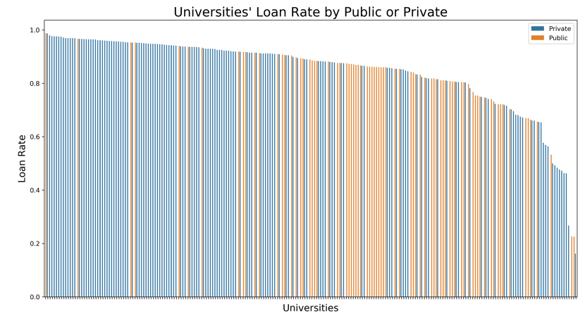
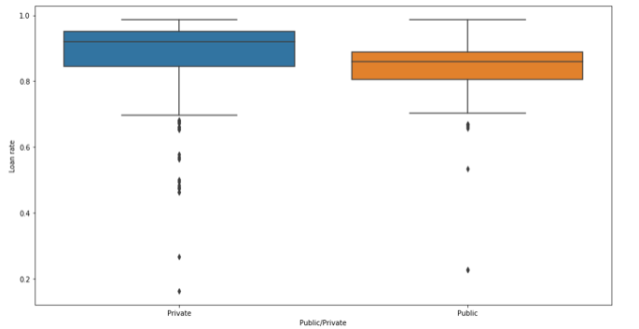
Private school students have higher average loan rates than public school students
But there is also large number of private universities enjoy low loan rate. Most public universities are in the middle range.

Slide 4
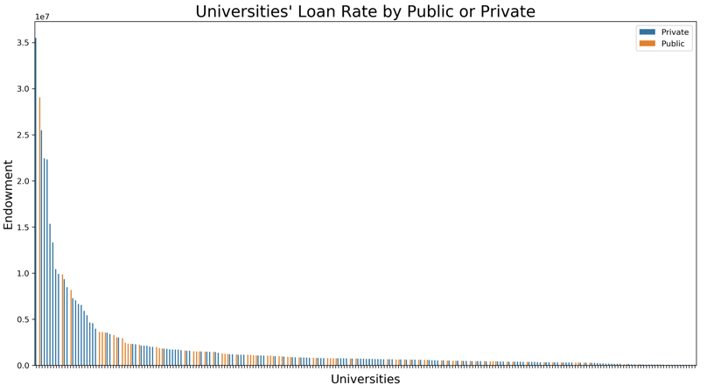
Private schools will get more endowments than public schools

Slide 5
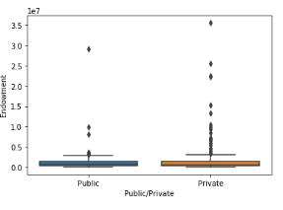
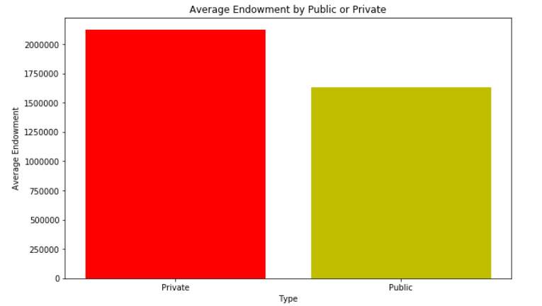
Private schools will get more endowments than public schools

Slide 6
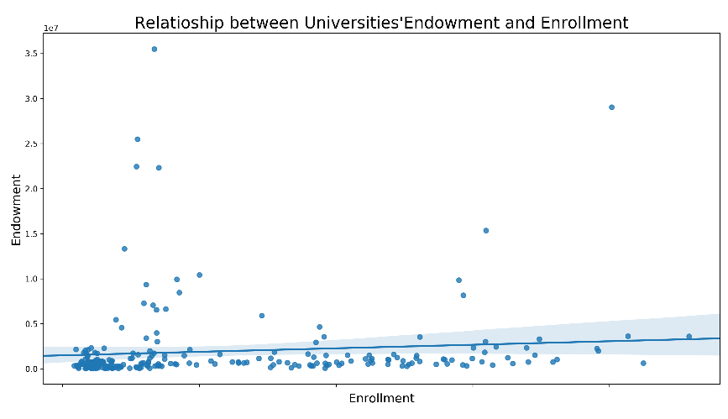
Universities with more enrollments do not necessary to have higher endowment

Slide 7
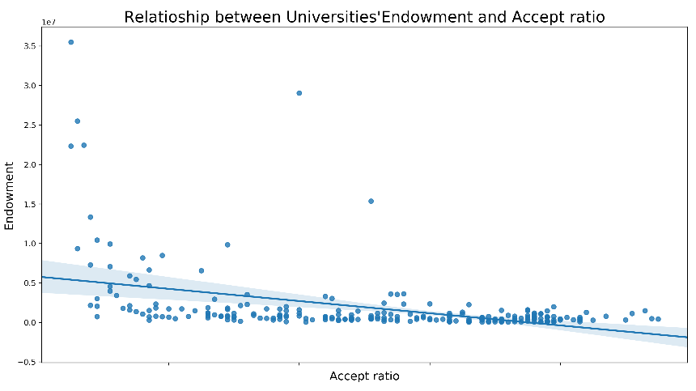
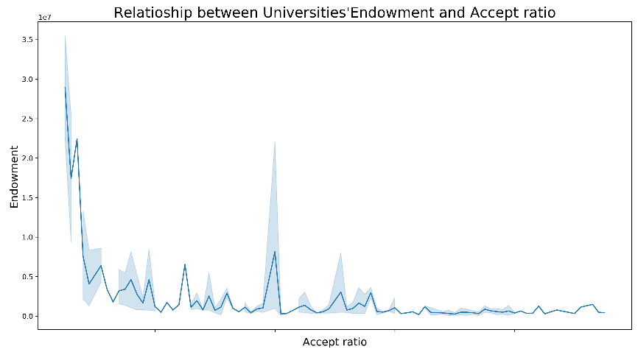
Universities with low acceptance ratios usually get more endowments

Slide 8
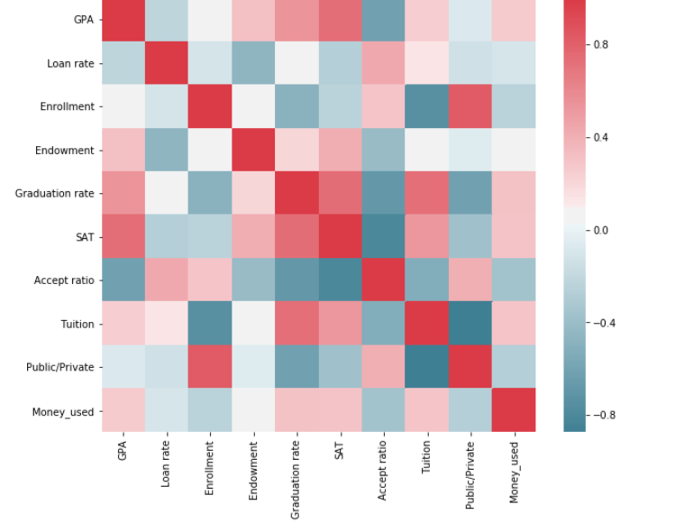
Correlation Matrix
Endowment is positively correlated with the SAT, GPA and Graduation rate.
Endowment is negatively correlated with Accept ratio, Loan rate and Public/Private.

Slide 9
PCA Analysis

Slide 10
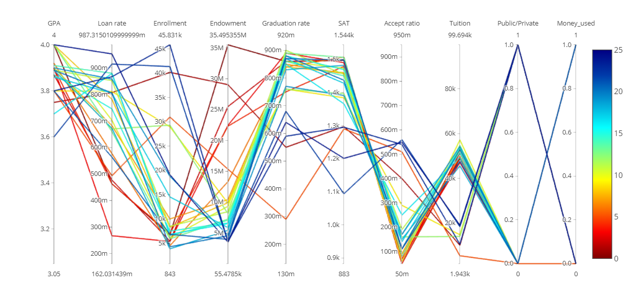
PCA analysis - Parallel Chart

Slide 11
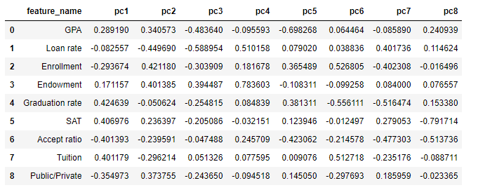
PCA analysis - PCs

Slide 12
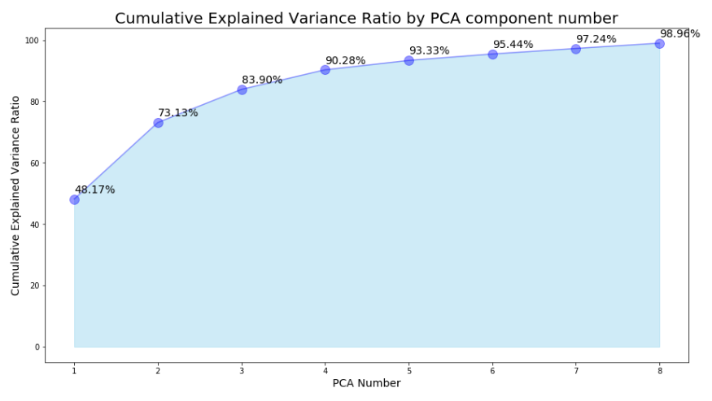
Cumulative Explained Variance Ratio by PCA component number

Slide 13
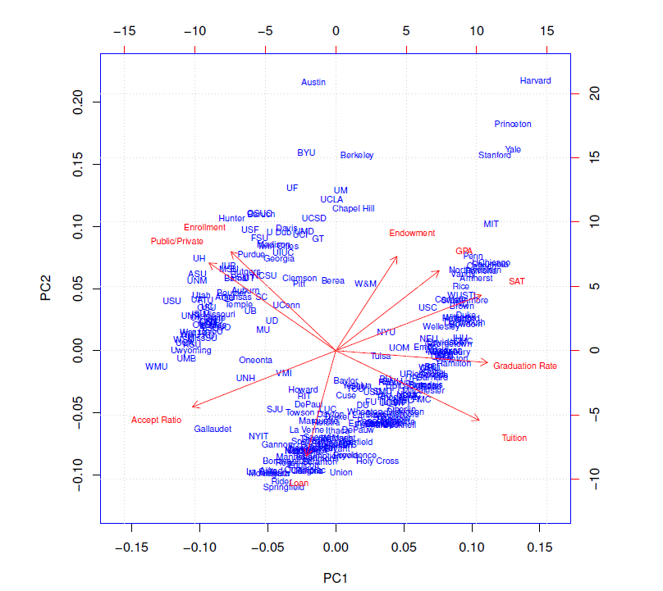
PCA analysis - Biplot

Slide 14
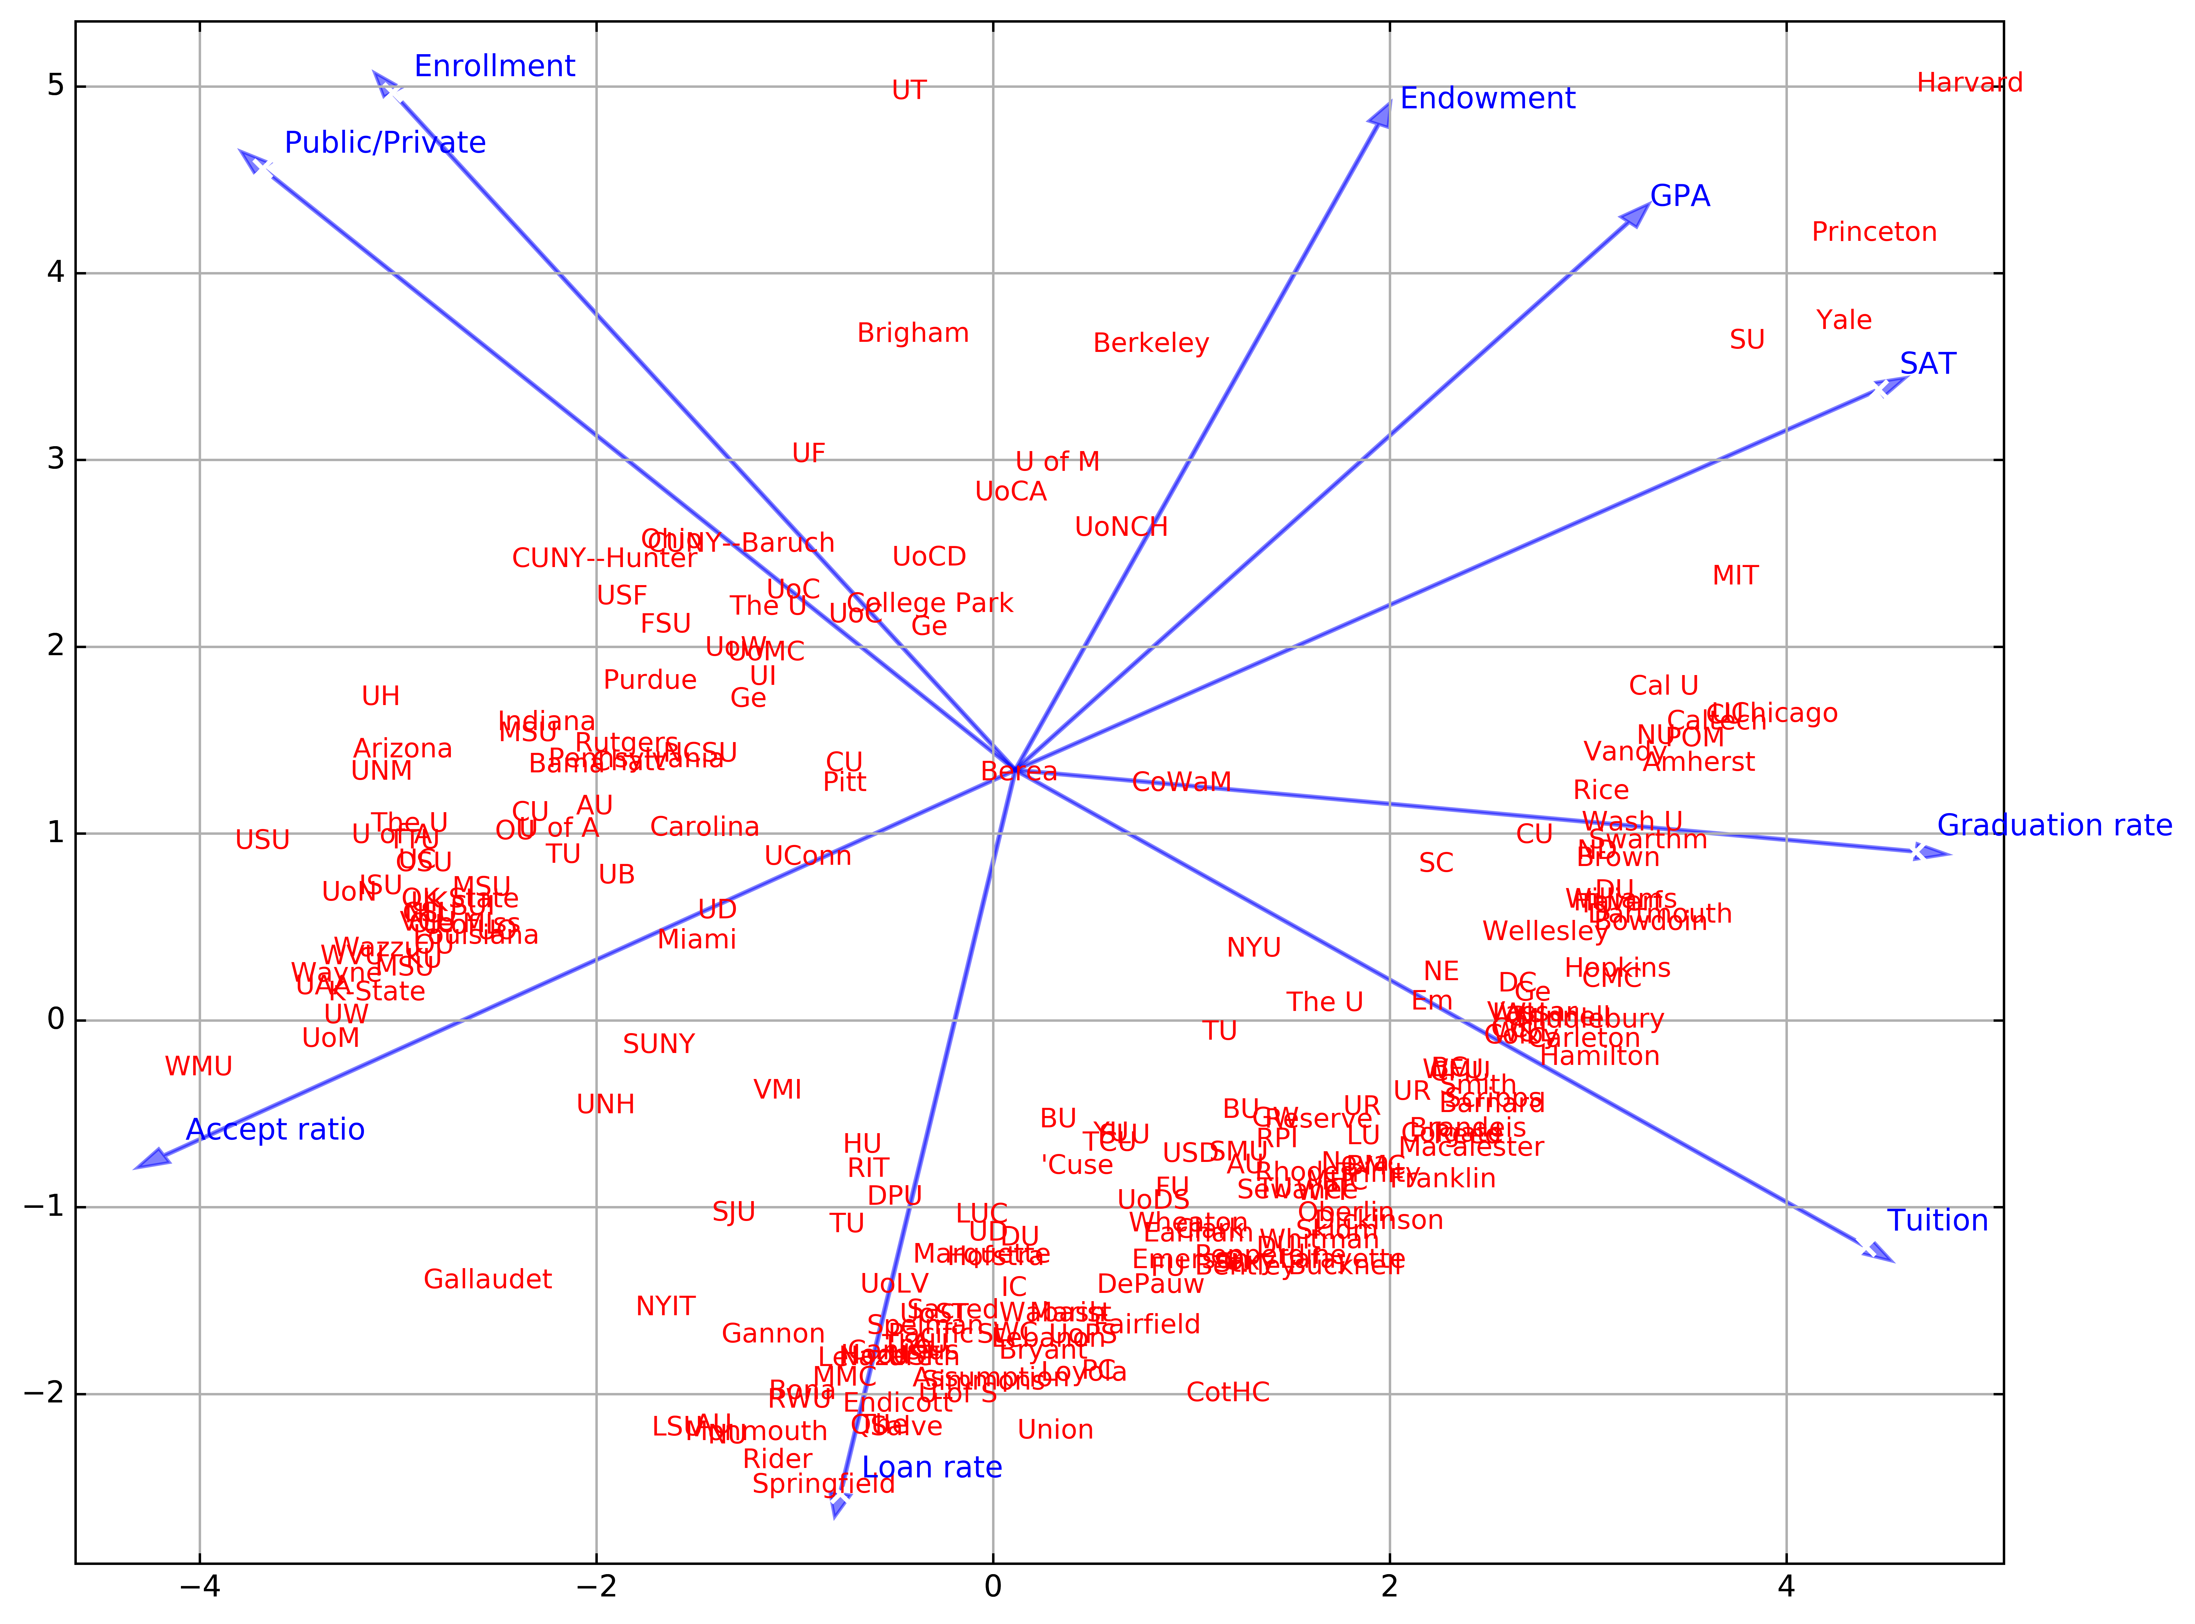
PCA analysis - Biplot

Slide 15
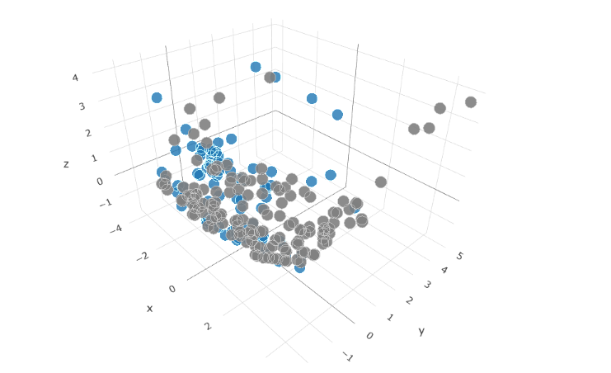
PCA analysis - Tri-plot

Slide 16
Twitter Analysis

Slide 17
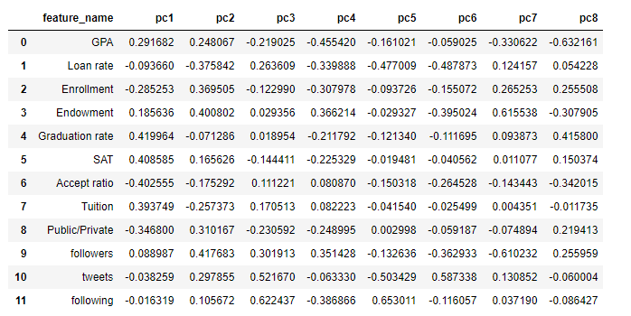
Twitter PCA analysis - PCs

Slide 18
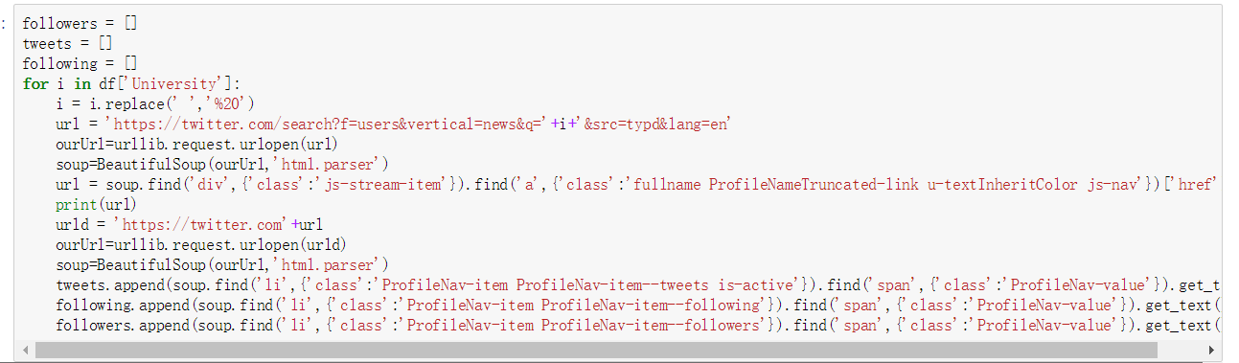
Crawlers

Slide 19
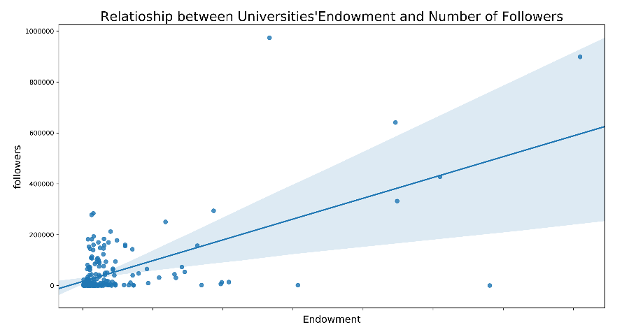
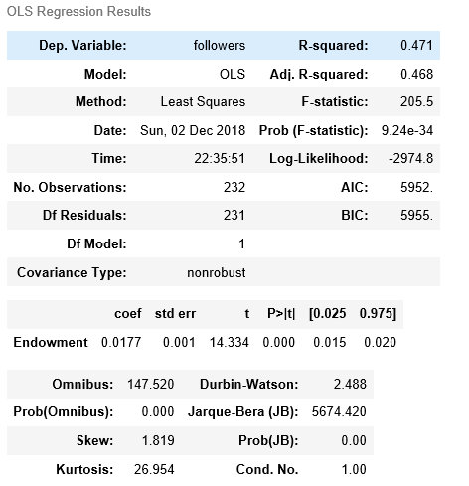
The richer a university, the more followers in its twitter

Slide 20
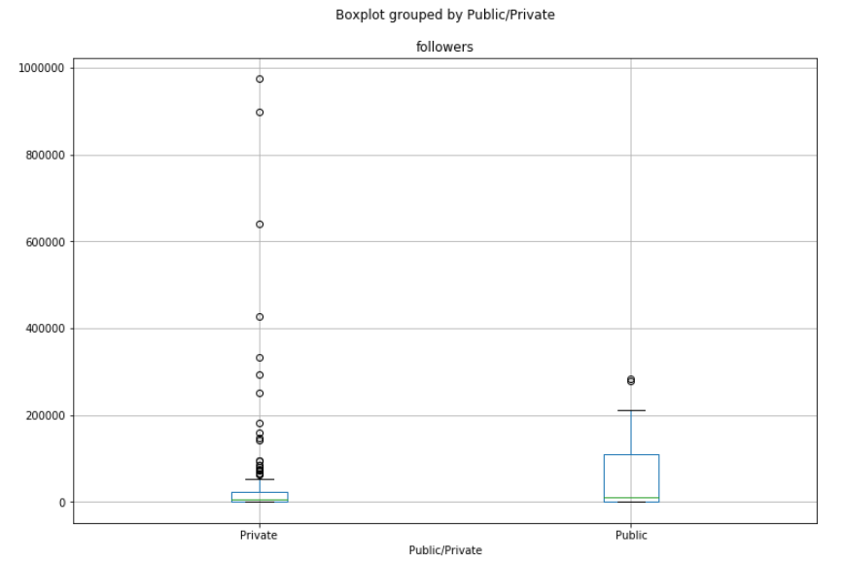
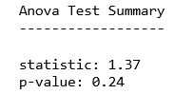
Private universities do not have significant difference with public universities regarding the average Twitter followers
But there are large part of private universities have higher number of followers on Twitter compared with the public universities.

Slide 21
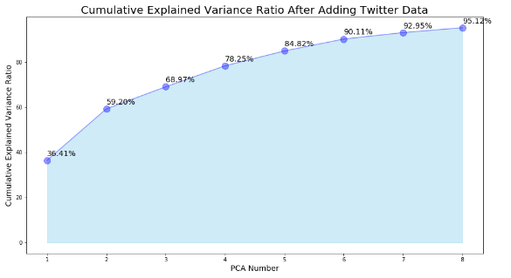
Cumulative Explained Variance Ratio by PCA component number

Slide 22
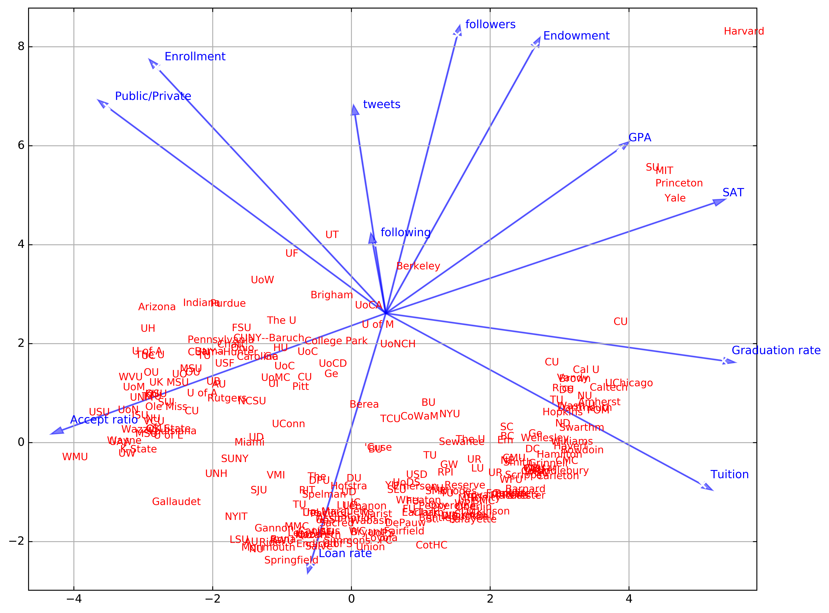
Visualize the data via PCA by including info we get from twitter

Slide 23
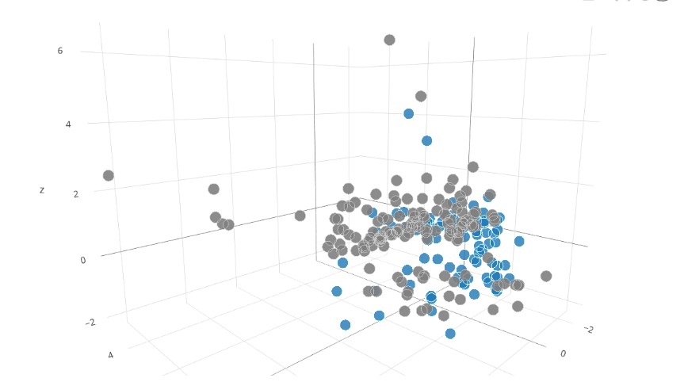
Twitter PCA analysis - Tri-plot

Slide 24
Machine Learning and Selective Learning

Slide 25
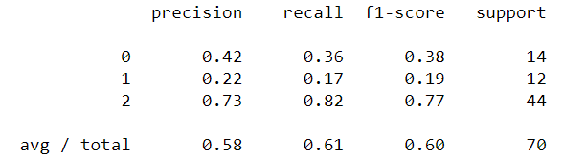
Extremely randomized trees (ET)--
Before parameter adjustment

Slide 26
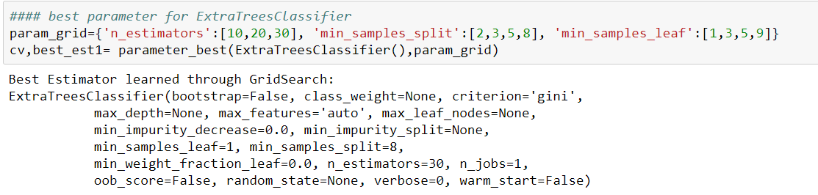
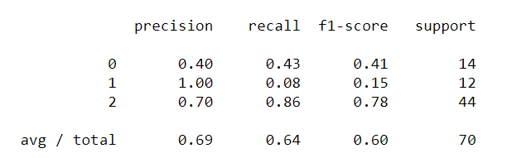
Extremely randomized trees (ET)--
After parameter adjustment

Slide 27
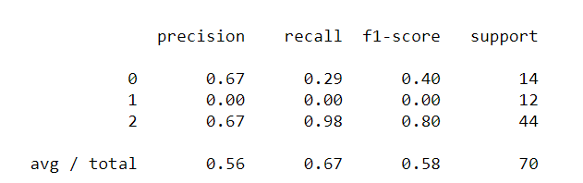
Random forests--
Before parameter adjustment

Slide 28
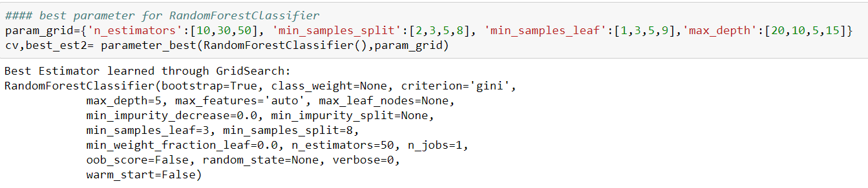
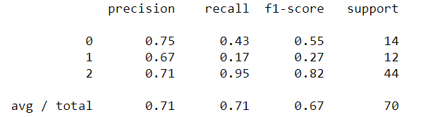
Random forests--
After parameter adjustment

Slide 29
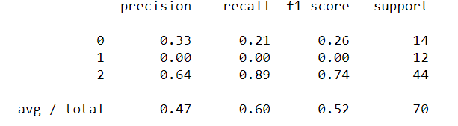
SVM --before parameter adjustment

Slide 30
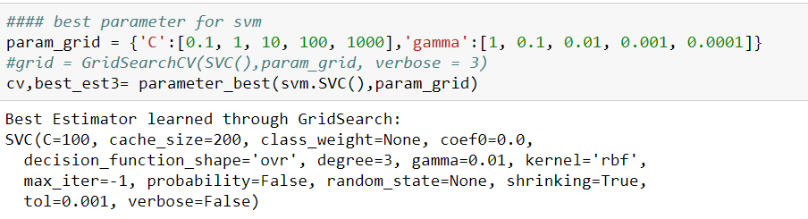
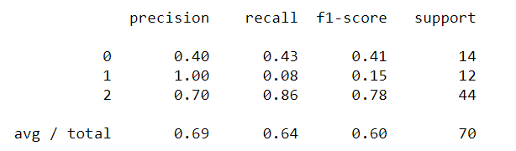
SVM--after parameter adjustment

Slide 31
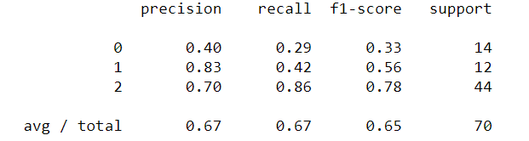
Gradient boosting--
Before parameter adjustment

Slide 32
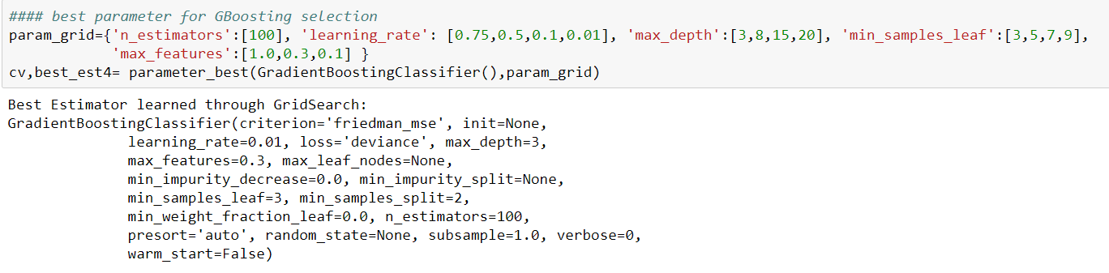
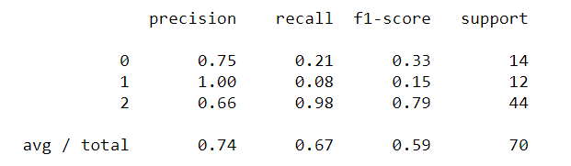
Gradient boosting--
After parameter adjustment

Slide 33
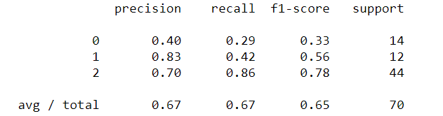
Deep neural networks (DNN)

Slide 34
Selective Learning
Transfer classification to regression: Logistic regression
Selection condition: probability error = 1 - false probability
Apply logistic regression to testing data to select good datasets

Slide 35
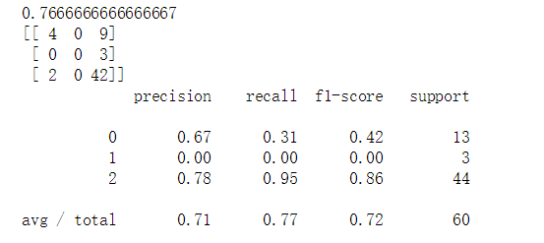
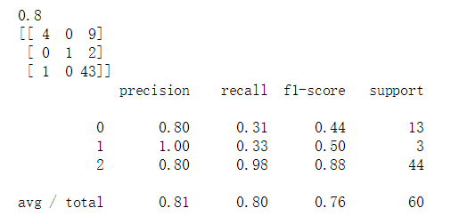
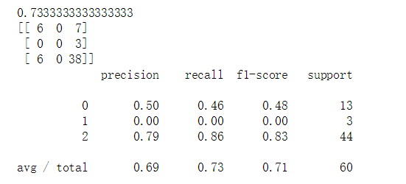
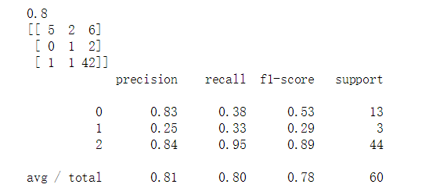
Results After Selective Learning
ExtraTrees
Random Forest
SVM
GradientBoosting

Slide 36
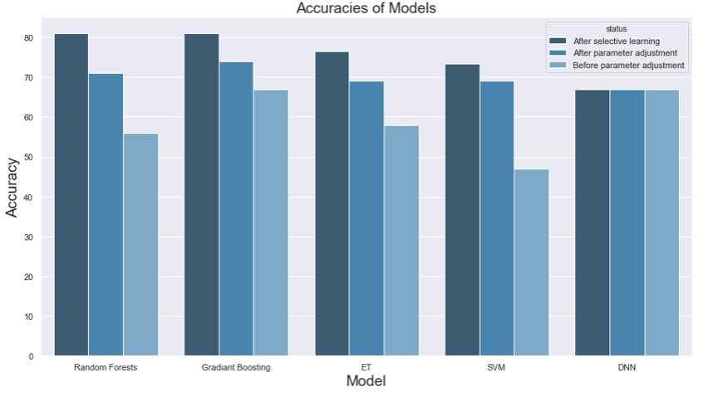
Comparison of the accuracy for all models

Slide 37
Learning Validation

Slide 38
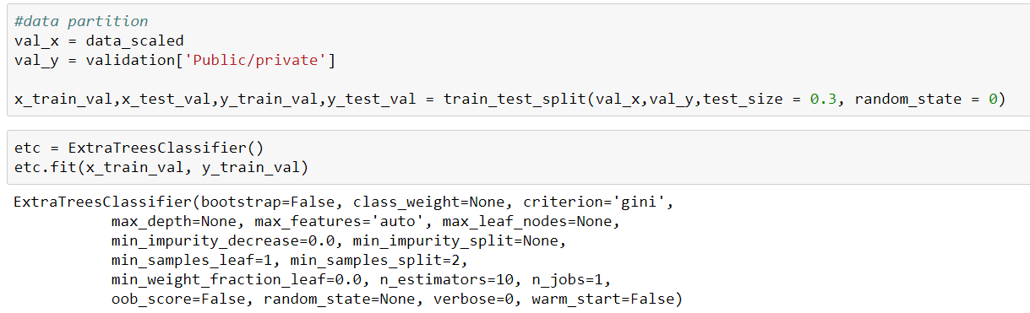
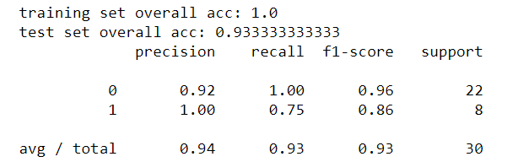

Slide 39
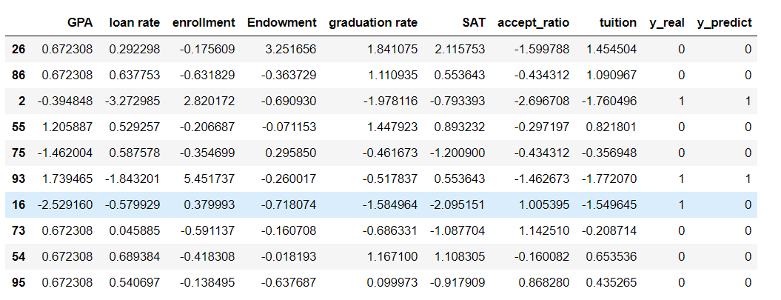
Validation_ans

Slide 40
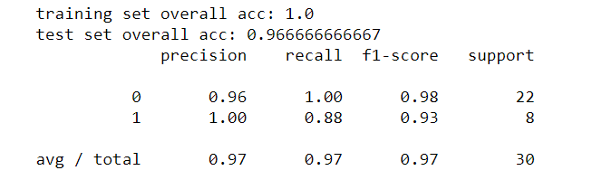
After selective learning

Slide 41
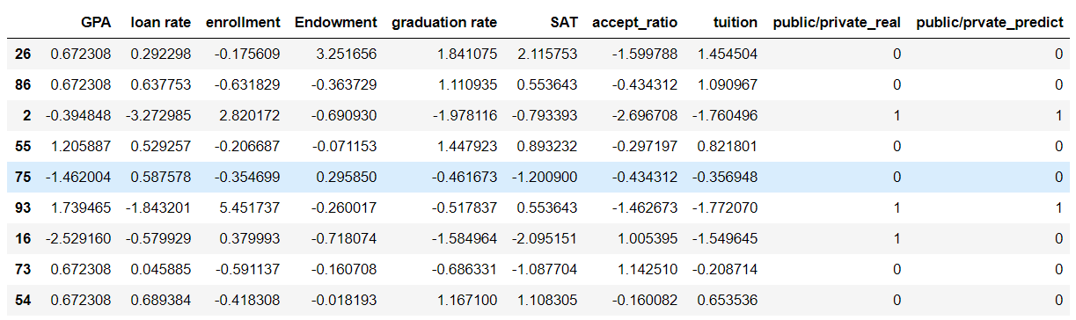
Validation_ans_sure

Slide 42
Thank You

